Slide 1
Digital Envelope
数位信封
Collaborators: 107316126, 107316127, 107316154

Slide 2
Outline 大纲
Abstract
Introduction
Terminology
Methods
Implementation
Application Introduction
Experiment
Conclusion

Slide 3





Abstract

Slide 4
Abstract
Digital envelope is section of encrypted data to be transmitted over network. It shall contains the encrypted message and encrypted random key. 数位信封是经加密的网路封包。封包该包含密文与加密后的金钥。
This method uses both symmetric encryption algorithm and RSA encryption algorithm. 此方法使用对称式加密演算法及公开金钥加密演算法。
The plaintext is symmetrically encrypted by a random key (>=128-bits) and the random key will encrypted using public key encryption method. 以至少128-bits的乱数对明文加密，并以接收者的公钥对乱数做加密。

Slide 5
Introduction
Computer Security Triad
Confidentiality
Integrity
Availability

Slide 6
Terminology 名词定义
Encryption VS Decryption
Block Cipher
Symmetric Encryption Algorithm
RSA (Rivest–Shamir–Adleman)

Slide 7
Related Work

Slide 8
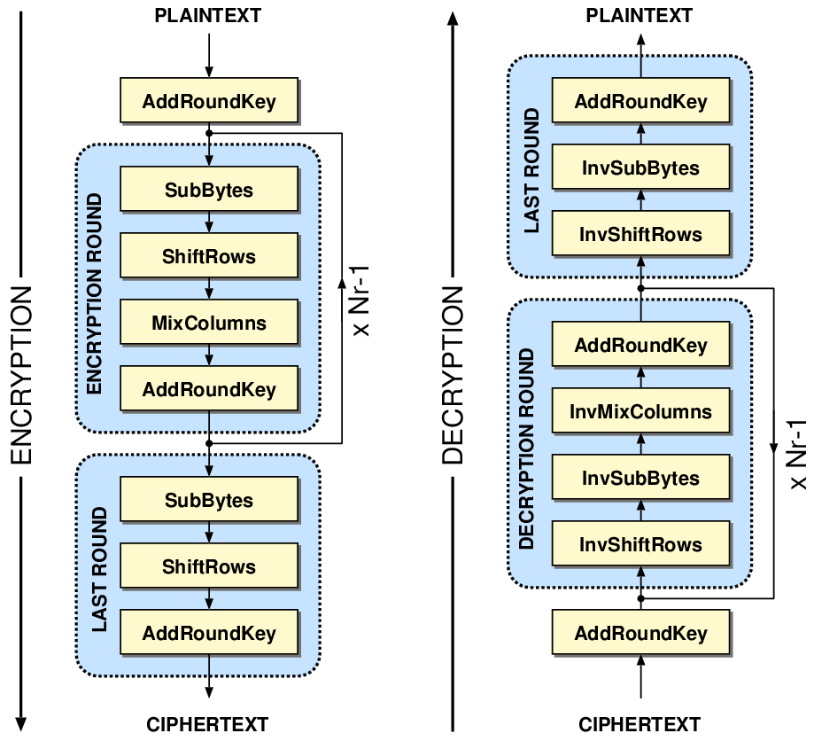
Symmetric
Encryption
Algorithm
Encrypt and decrypt with the same key

Slide 9
AES Algorithm - RFC3602
2.2. Key Size and Number of Rounds
Key size: { 128, 192, 256 }
No. of Rounds wrt key size: {10, 12, 14}
2.4. Block Size and Padding
The AES uses a block size of sixteen octets (128 bits)
Padding is required by the AES to maintain a 16-octet (128-bit) block size.
Notes:
Link: https://tools.ietf.org/html/rfc3602

Slide 10
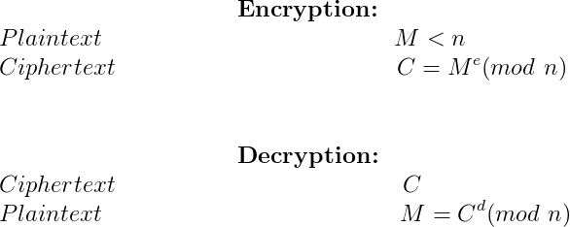
RSA Algorithm - RFC8017
Notes:
Link: https://tools.ietf.org/html/rfc8017

Slide 11
Method
In this paper we attempt to address two critical concern:
Efficiency AES rather than RSA for message encryption
Vulnerability 128-bit AES message encryption and 2048-bit RSA key encryption

Slide 12
Implementation 实作方法
Environment环境: Windows 10, Pop!_OS 20.10
Programming Language程式语言: Python 3.8
Dependencies函式库:
PyCryptodome==3.10.1
Transmission Protocol传输协定: TCP
Data Structure: JSON
Scenario情景: Message exchange between two individual machine 两台独立的计算机互相交换信息

Slide 13
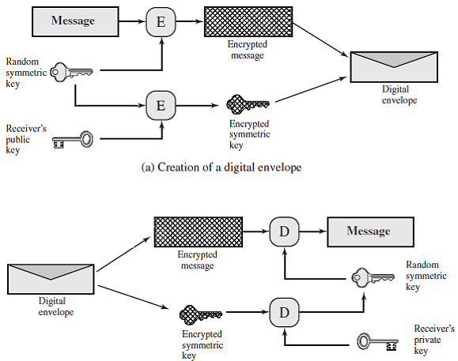
Process
Diagram
流程图

Slide 14
Application Introduction 系统简介

Slide 15
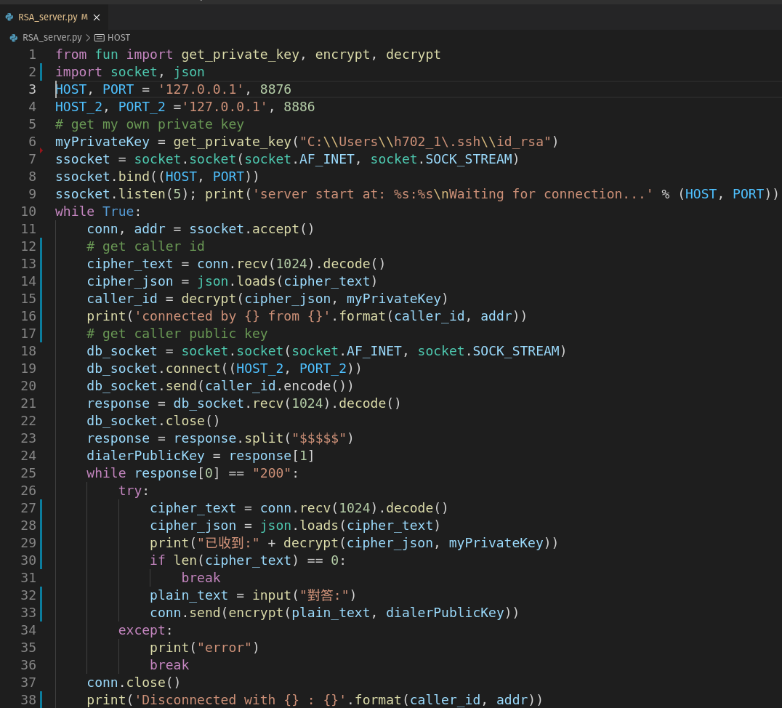
TCP-Server
Get Dialer ID
Get Dialer Public Key
Encrypt & Decrypt

Slide 16
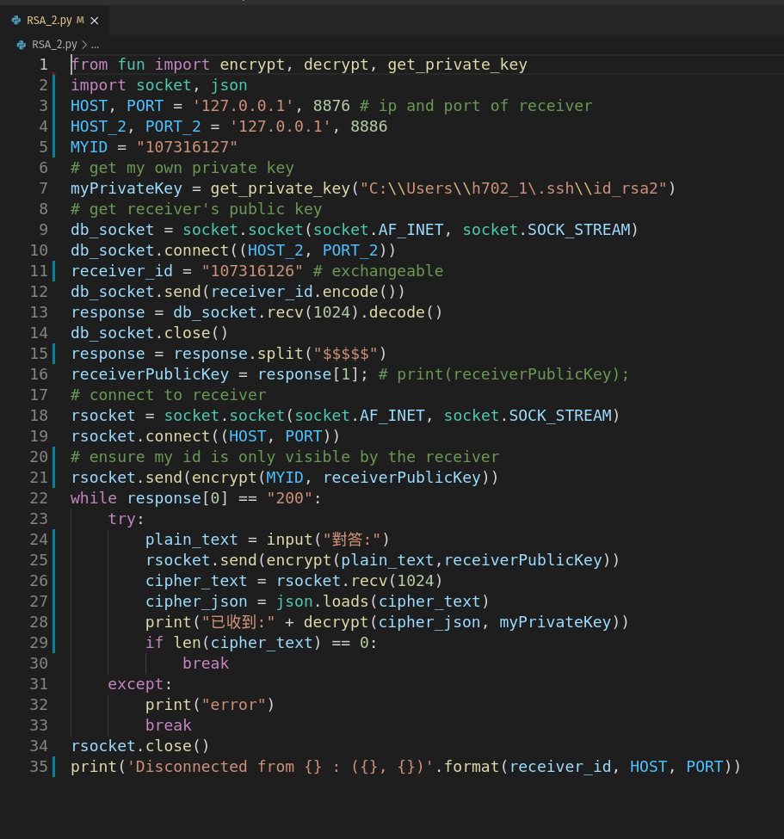
TCP-Client
Get Public Key Of Receiver
Tell Receiver My ID
Encrypt & Decrypt

Slide 17
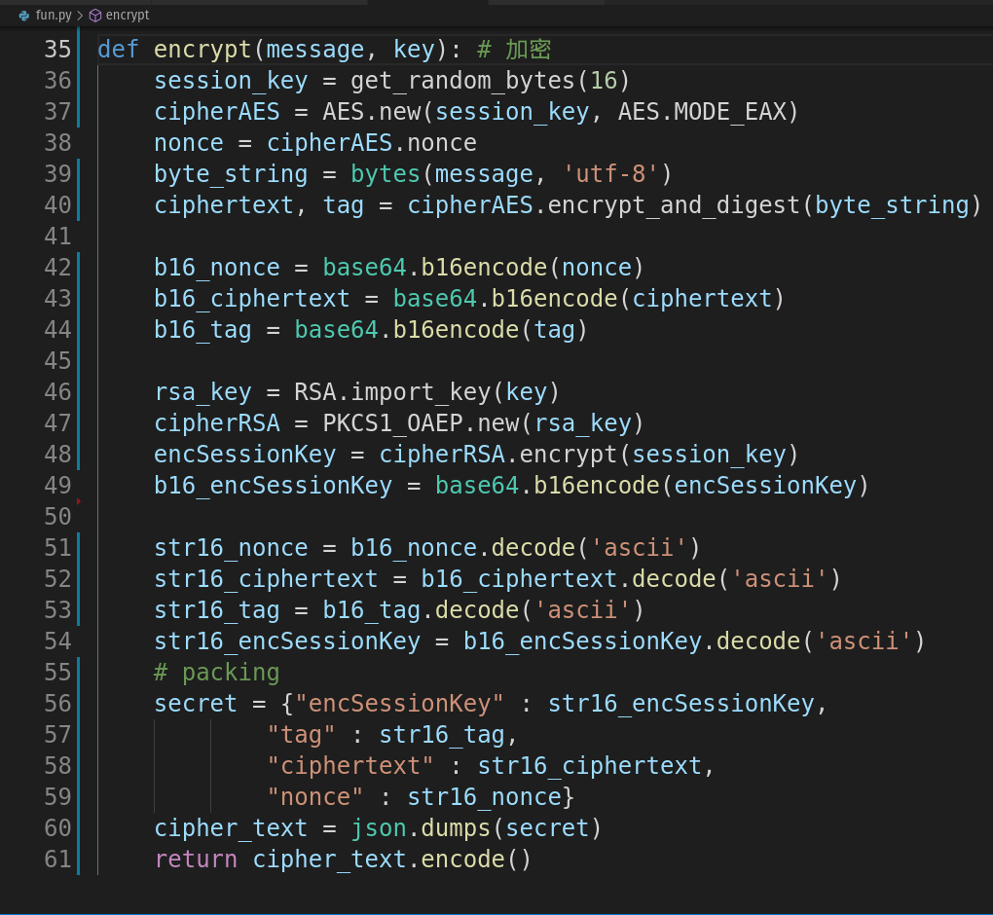
Encrypt
Random Key
AES Encryption
RSA Encryption

Slide 18
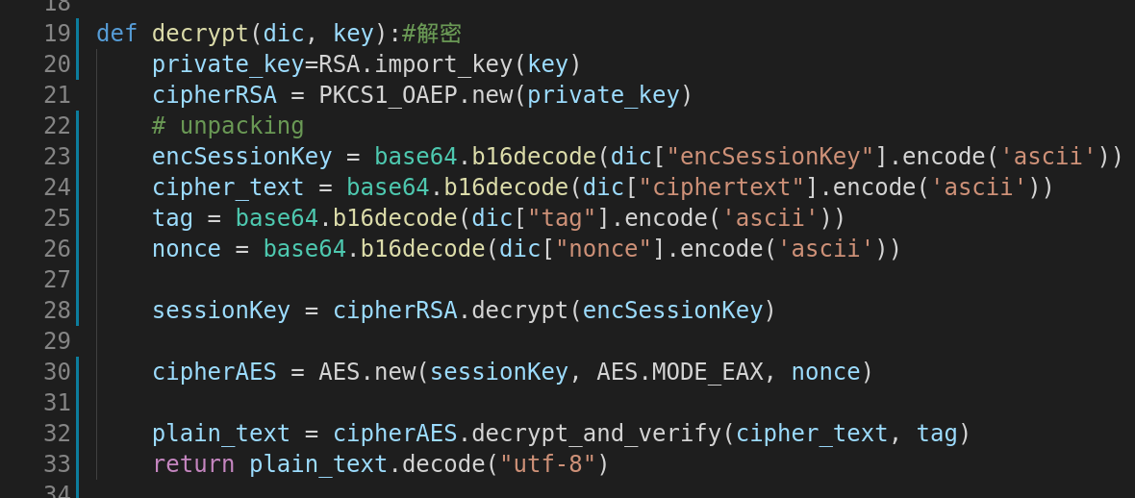
Decrypt
Unpacking
RSA Decryption To Get Random Key
AES Decryption To Get Plain Text

Slide 19
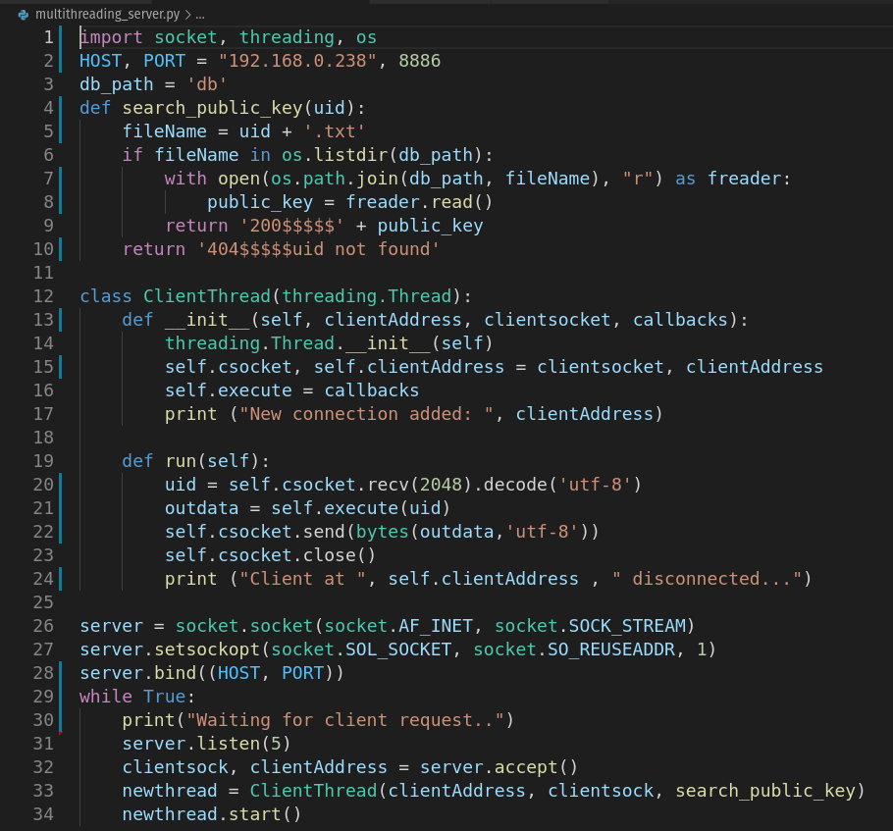
DB-Server
Simple server application that support query of public key.
Input: User ID
Output: - Found: 200$$$$$User Public Key - Not Found: 404$$$$$uid not found

Slide 20
Experiment
Users are able to send and receive encrypted messages in real time speed using our system. Messages were not modified from sender to receiver end. For simplicity's sake , cryptanalysis and stress tests were not performed.

Slide 21
Conclusion
The protocol we proposed was able to achieve our goal of secure real time communication. However, many aspects like scalability and vulnerability of our protocol were not tested. Besides this, we did not compare the effectiveness of multiple protocols. Future research efforts will focus on testing the robustness of the protocol.

Slide 22
Thank you!

